Slide 1
Critical Design Review
Robotics Project
Team D
A01372581 | Marcos Eduardo Castañeda Guzman
A01372286 | Gerardo Uriel Monroy Vázquez
A01371852 | Emmanuel Hernández Olvera

Slide 2
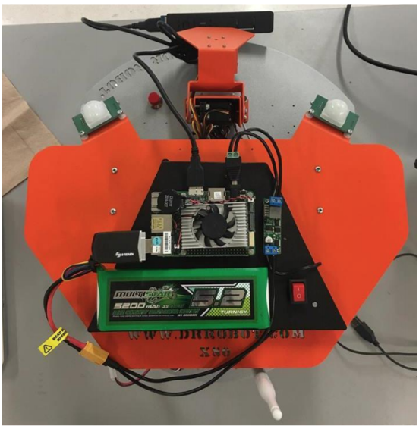
Mechanical design
Weight: 3.5 kg
Dimensions: diameter of 38 cm and height of 25.5 cm
Two DC motors with 22 kg·cm torque each
A maximum linear speed of 1 m/s according to its manufacturer
Designed to move in flat surfaces

Slide 3
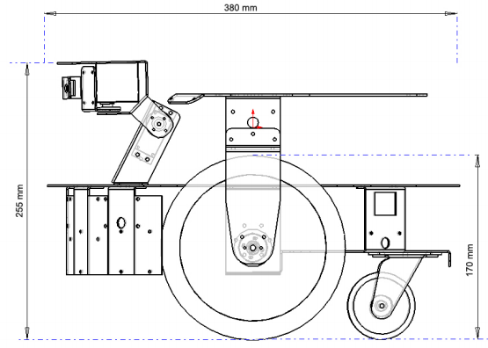
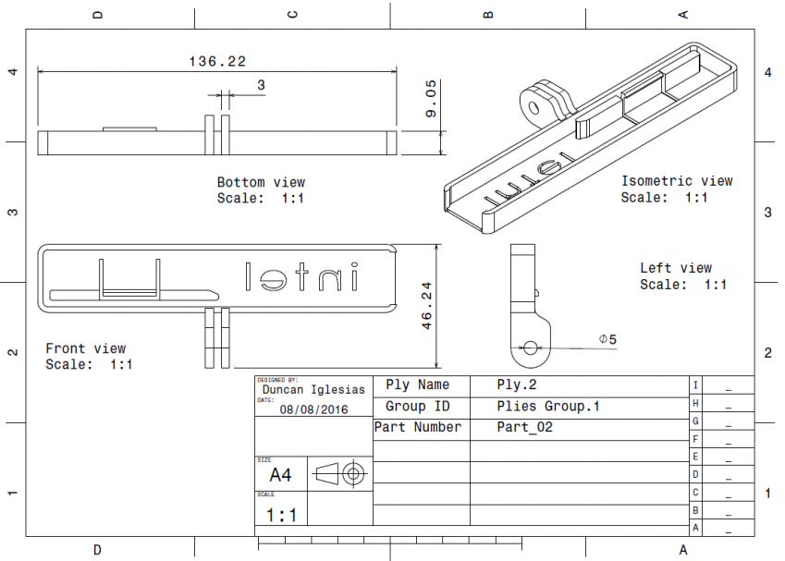
Mechanical design

Slide 4
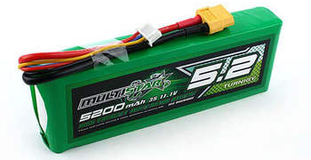
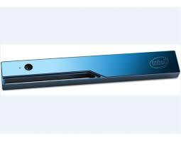
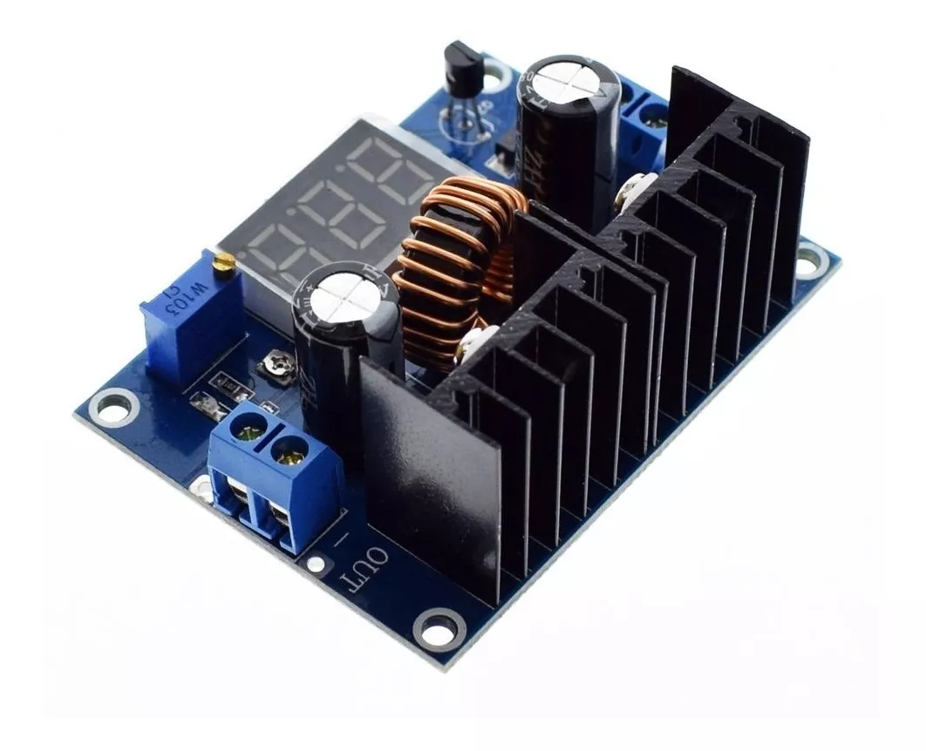
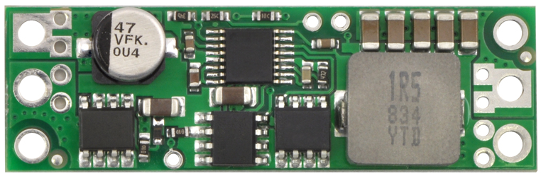
Electrical design and Sensor
R200 Real-Sense Intel
11.1 V LiPo Battery
XL4016 Buck Converter
7.5VDC
D15v70F5S3 Regulator
5VDC

Slide 5
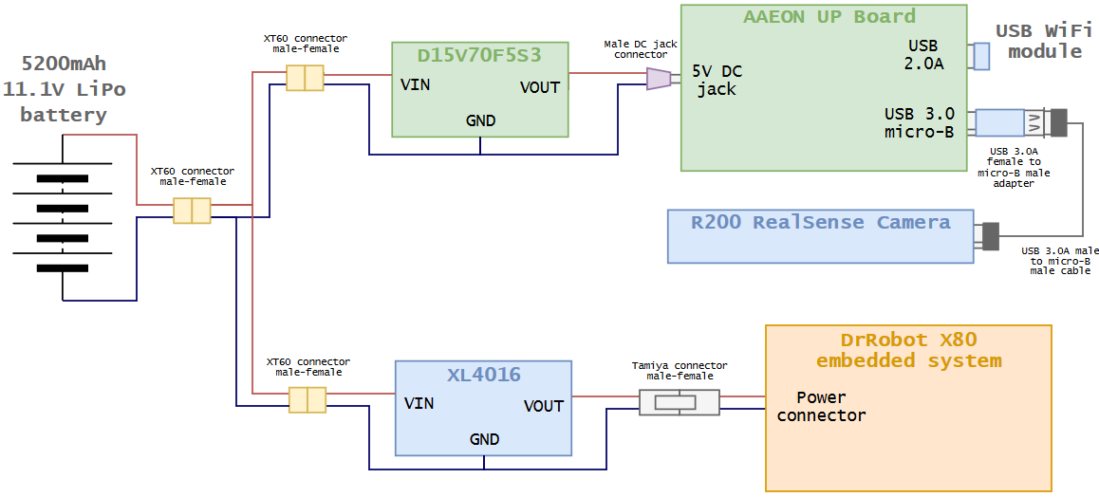
Electrical design

Slide 6
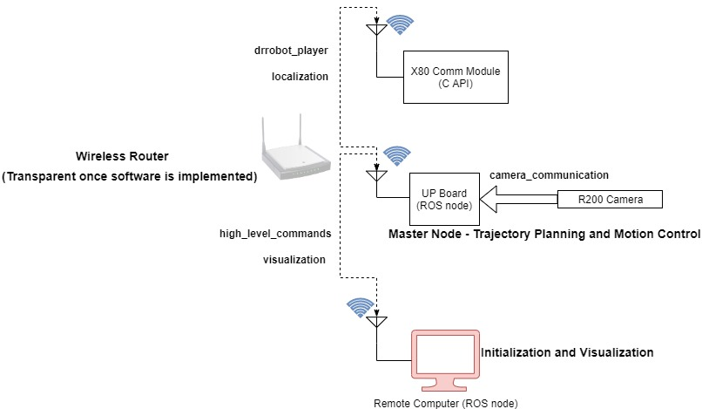
Software

Slide 7
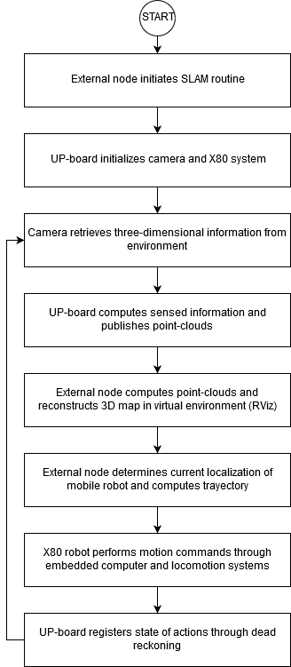
Software

Slide 8
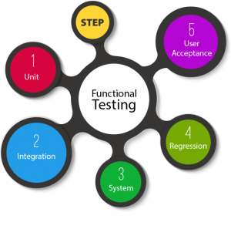
Plan for implementation and testing
Functional Testing
Unit testing: individual software modules or components that make up an application or system.
Integration testing: different modules/components that have been successfully unit tested when integrated together to perform specific tasks and activities.
System testing: black-box testing method, where the software is checked for user-expected working conditions as well as potential exception and edge conditions.
Acceptance testing: all the product/project requirements have been met and that the end-users and customers have tested the system
Notes:
PUDUL

Slide 9
References
[1] Dr. Robot. (2006). WiRobot X80 USER MANUAL. Retrieved from https://www.cs.princeton.edu/courses/archive/fall11/cos495/X80_Manual.pdf
[2] López, S.O., Azúa, L.D. and Monasterio, D.O. (2017). RealSense Reporte Final. México: ITESM.
[3] Intel Corporation. (2016). Intel RealSense Camera R200. Retrieved from https://www.intel.com/content/dam/support/us/en/documents/emerging-technologies/intel-realsense-technology/realsense-camera-r200-datasheet.pdf
[4] AAEON. (2019). UPDatasheetV8.5. Retrieved from http://data-us.aaeon.com/DOWNLOAD/2014%20datasheet/Boards/UPDatasheetV8.5.pdf
[5] Naylamp Mechatronics. (n.d). Convertidor Voltaje DC-DC Step-Down 8A 300W XL4016. Retrieved from https://naylampmechatronics.com/conversores-dc-dc/127-convertidor-voltaje-dc-dc-step-down-8a-300w-xl4016.html
[6] Pololu Corporation. (2019). Pololu Step-Down Voltage Regulator D15V70F5S3. Retrieved
from https://www.pololu.com/product/2111/specs

Slide 10
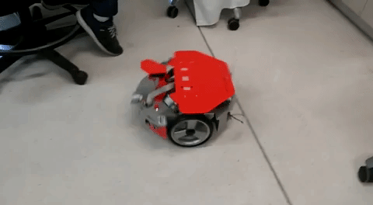

Slide 11
